Slide 1
Implementation and Analysis of An Efficient CRM-Data Mining Framework
CMPE 255 Final Project Presentation
Presented by:
Ryan Haoyuan Wang
Chao Pi
Xunan Dai

Slide 2
Introduction
An extension of the significant paper
A framework for CRM customer behavior prediction
Enhance the original work with exploration of methods of data preprocessing, diversifying variety of algorithm selection and expanding evaluation metrics
Dataset Preprocessing Techniques
Dealing with missing values
Feature selection/reduction
Algorithm Selection
SVM, K-NN and Decision Tree
Evaluation Metrics
Prediction accuracy, Computation time, ROC-AUC
Notes:
What we have done in this project is we enhanced the original work with
Exploration of methods of data preprocessing
We selected a variety of algorithm for testing
And we expanded the evaluation metrics to evaluate our framework

Slide 3
Dataset Introduction
A Portuguese bank’s campaigns offering customers with an long-term deposit application
Original dataset has 58 columns
21 columns left with sensitive personal information removal
Customer’s information
Age, job, marital status, education level, if has credit in default and if has loan on housing
Customer’s relationship with the bank
Contact communication type, last contact date and last contact duration in seconds, number of previous contacts, the previous outcomes, etc,.

Slide 4
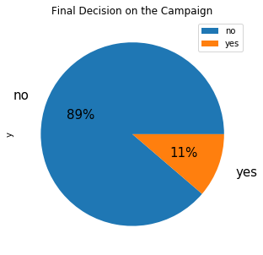
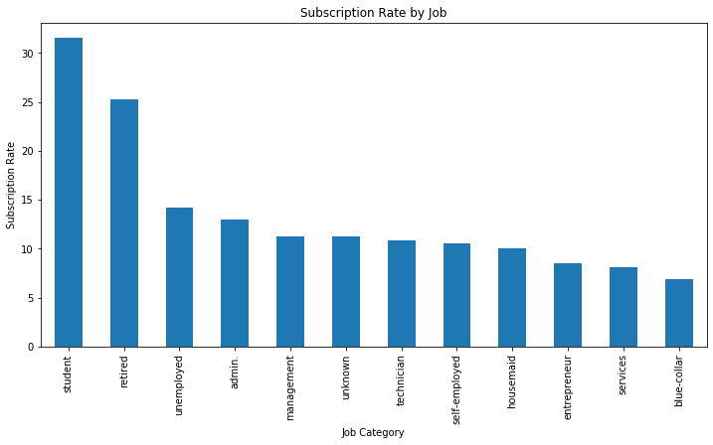
Dataset Analysis
Notes:
Next, I’ll introduce the analysis of the data. First let’s take a brief glance of the project status.
Notice that most customer didn’t accept the subscription, which macke sence. And there’s a subscription rate rank by the job category. The student and retired person take them most part, this feature will also occur later.

Slide 5
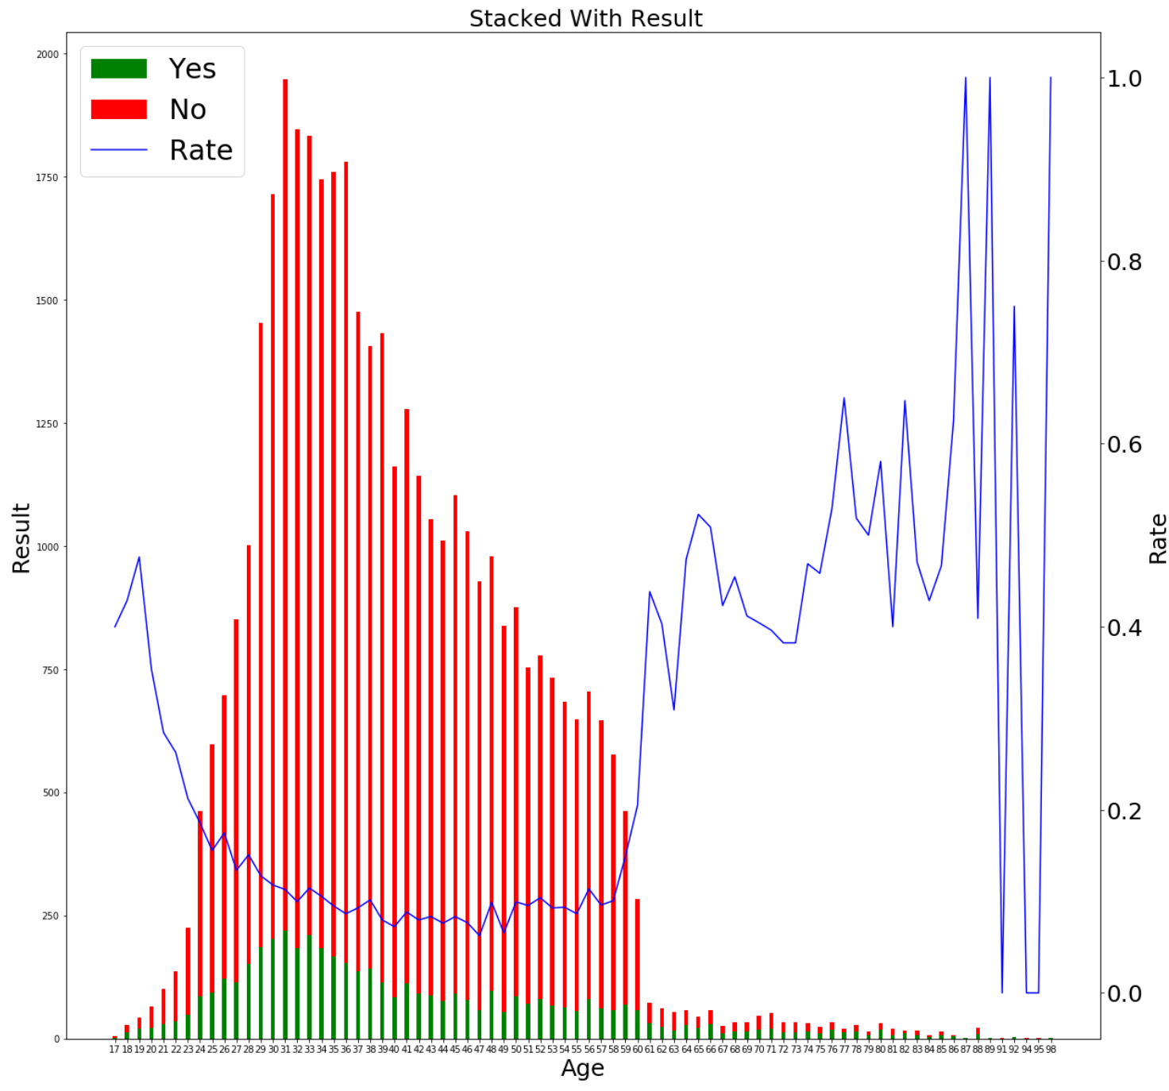
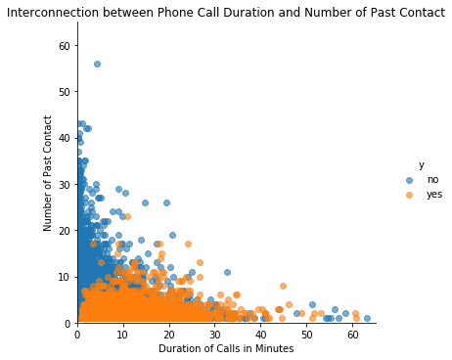
Dataset Analysis
Notes:
Now let's see the agee distribution. It turns out that the data set mainly located between 20 to 60, but the accept rates are inverted.
We also plot the result with the number of past contract and duration of calls in minutes. We can see that the frequent call will cause failure, as well as the duration. Customers have no patience with your introduction.

Slide 6
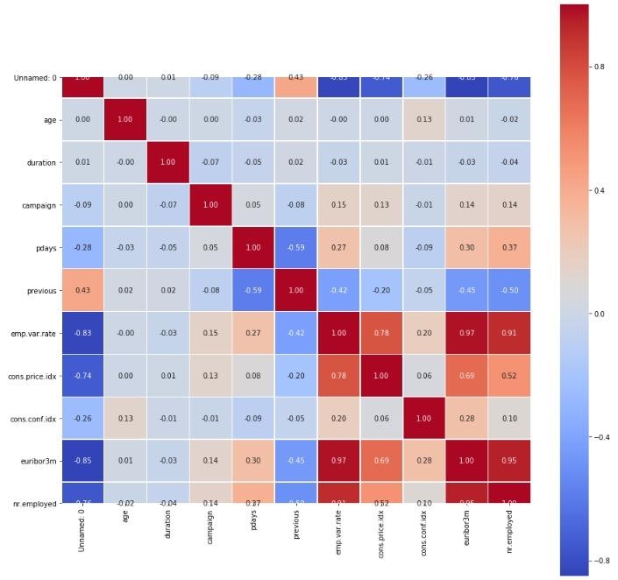
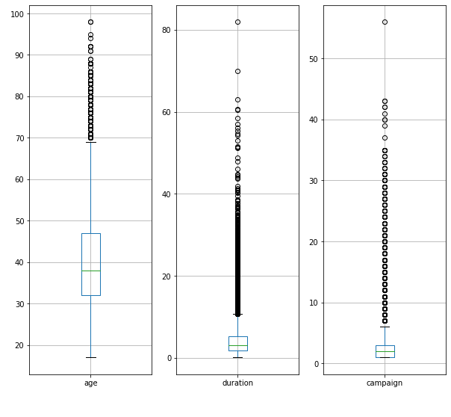
Dataset Preprocessing
Missing values
Dropping, “unknown” blocks as a class and predicting imputation
Outlier analysis
Box plot to analyse numerical attributes
Feature Selection
Highly correlated attributes removal using correlation map
Feature reduction
PCA
Notes:
Since there were so many feature, we need to do a lot of preprocessing jobs in order to reach a better performance. We implemented many methods to achieve the goal . First we need to deal with the missing values, the simplest way is dropping the instance with missing values, but this will cause massive information lost. So we try to impute the missing values. For numerical values, we can use the mean value , but it’s impossible for the categorical features, so we try to predict these values by other known data.
We also handle with the outlier and correlation analysis. As shown in the hot map and box plot. We select the feature by doing these analysis, and also using PCA to do feature reduction by selecting the most important features and comparing the result with or without PCA.

Slide 7
Algorithms
Output ‘y’ (Yes, No)
Classification Problem:
Neural Network
Suitable for both linear and non-linear dataset
Naive Bayes
Baseline and generate good result in most cases
SVM
Efficient in high dimensional data
Decision Tree
Handle both numerical and categorical data
KNN
Works well in high dimensional and non-linear data
Notes:
Since this is a classification problem, we implement five most popular and effective models with the data. Different models owns different pros and cons.
NN: powerful, longer time, hard to fine tune para
NB: Easy quick, based on math assumption, independent
SVM: Longer computation time, kernel selection and compare
DT:Not complex, ,result is understandable,
KNN: Lazy learning, no training but long time testing,. Sensitive to outliers,

Slide 8
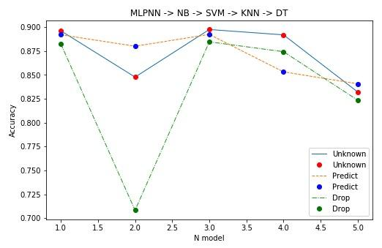
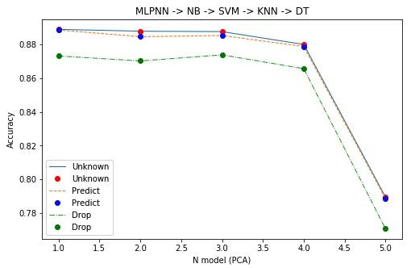
Evaluation and Validation
Accuracy comparison among three data preprocessing methods with PCA or without PCA

Slide 9
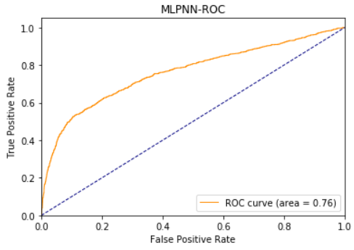
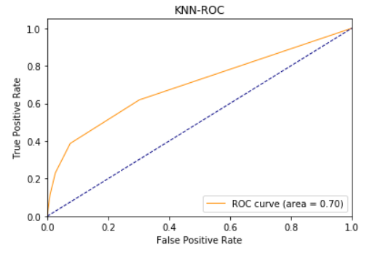
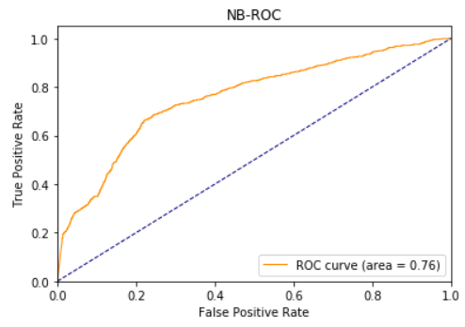
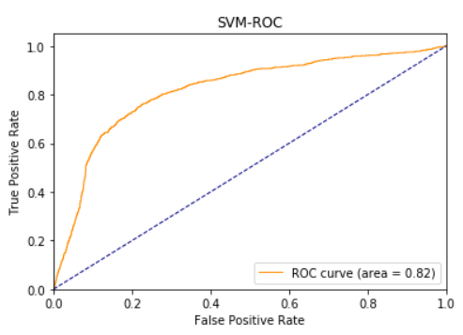
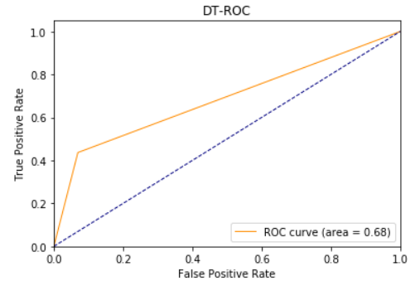
ROC & AUC
0.76
0.70
0.76
SVM won
DTree lost
0.82
0.68

Slide 10
Conclusion
Things Worked:
Visualizing dataset gives a general picture of each attributes
Selected models gives satisfactory prediction
Effective data reduction method (PCA)
Things Didn’t Work Well:
Feature selection may not be the best
Feature transformation may include bias (One-hot Encoding)

Slide 11
Rubric
Data Collection | Variety | Visualization | Presentation | Significance to the real world
Data Reduction | Veracity | Code Walkthrough | Report | Tools usage
Volume | Version Control | Discussion | Lessons learnt | Prospects of winning
Velocity | Innovation | Evaluation | Teamwork | Technical difficulty

